Slide 1


Integrating Health Data for Sustainable Development
Data Integration Project
Step 2: Integrating
Huthayfa Mutan

Slide 2
Experiments. Chosen Datasets:
Out of hundreds of overwhelming datasets about multiple of large sets of indicators, the choosing data sets are the following:
Global Health Spending 1995-2019
https://ghdx.healthdata.org/record/ihme-data/global-health-spending-1995-2019
Global Burden of Disease Study 2019 (GBD 2019) Healthcare Access and Quality Index 1990-2019
https://ghdx.healthdata.org/record/ihme-data/gbd-2019-healthcare-access-and-quality-1990-2019
Reasons of choosing:
1- Contains multiple valuable indicators over a wide range of countries.
2- Well documented datasets.
3- Valuable data for the goal of the project.

Slide 3
Pipelining:
Since the Healthcare Access and Quality Index dataset have similar values for multiple rows, such as: country name, indicator name, the first step is to convert these into a format easier to integrate which will be in the shape of:
(Country,Year) -> Set of indicators

Slide 4
Algorithms:
String matching to match country names and codes and using the documentation of each dataset to match correctly.
Date Matching to match the dates.

Slide 5
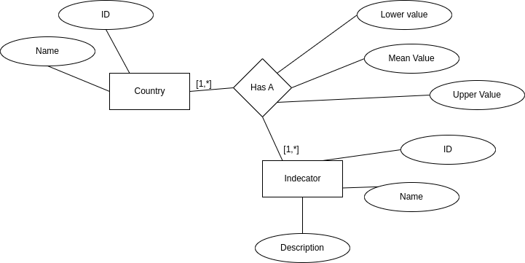
ER diagram

